Slide 1



TEAM
KYZNS
KONDAPALLI SANDEEP
YUVARAJ D B
ZUBER
NAVEEN KUMAR
SYED ISMAIL

Slide 2

TEAM TRAVEL PLANNING TOOL

Slide 3

INTRODUCTION:
A Team Travel Planning Tool is a software platform designed to streamline the process of organizing group travel, typically for businesses, sports teams, or large organizations. It simplifies tasks such as booking flights, accommodations, transportation, and managing itineraries, while ensuring that the specific needs of the group are met.

Slide 4

To develop a team travel planning tool that streamlines and simplifies the coordination of the team trips by providing features such as cost tracking , transportation and accommodation bookings and team communication.
By improving efficiency and reducing time spent logistics.
Hhhjdjdjdjjdjdjdjdjdjd
OBJECTIVES:

Slide 5
ALGORITHM:
1.Input team details :
Gather information about team members.(names,contact informations
2.Define trip parameters:
Specify destination, travel dates and budget
3.Budget Allocation:
Estimate cost for travel, food and activities.
4.Transportation and accommodation Booking:
search and compare options for transportation.

Slide 6
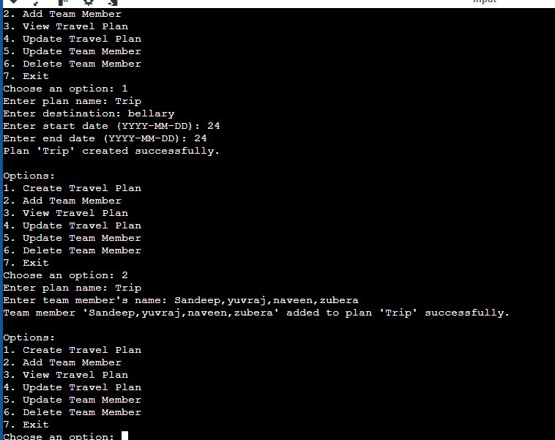
RESULT:

Slide 7
CONCLUSION
The Team Travel Planning Tool program is a user-friendly and efficient software solution designed to manage team travel plans. The program allows users to create, view, update, and delete trips, as well as add and manage team members. With its intuitive menu-driven interface, users can easily navigate and perform various operations.

Slide 8
FUTURE ENHANCEMENT
Future enhancements for a team travel planning tool could incorporate cutting-edge technology to make the process more seamless, efficient, and user-friendly. Here are key areas for improvement:

Slide 9


